Slide 1
Lesson 2: Decision Trees

Slide 2
Today’s Agenda
Gini impurity
Entropy
Information gain
Classification tree
Regression tree
Variable importance

Slide 3
Learning Objective
By the end of this session, you should be able to:
Explain/demonstrate how Gini impurity is used for constructing decision tree.
Compare entropy to Gini impurity.
Explain/demonstrate how information gain is used for constructing decision tree.
Differentiate between classification tree vs. regression tree.
Apply recursive partitioning used for constructing classification / regression tree.
Tune
Apply regularization to decision tree to prevent overfitting.
Extract variable importance to interpret the decision tree model.

Slide 4
The Basics of Decision Trees

Slide 5
Types of Decision Trees
Categorical Variable Decision Tree: Decision Tree which has categorical target variable
Continuous Variable Decision Tree: Decision Tree which has continuous target variable

Slide 6
Pros and Cons
Tree-based methods are simple and useful for interpretation.
Tend to overfit leading to poor performance.
We also discuss bagging, random forests, and boosting.
Combining multiple trees to often yield improvements in prediction accuracy, at the expense of some loss interpretation.

Slide 7
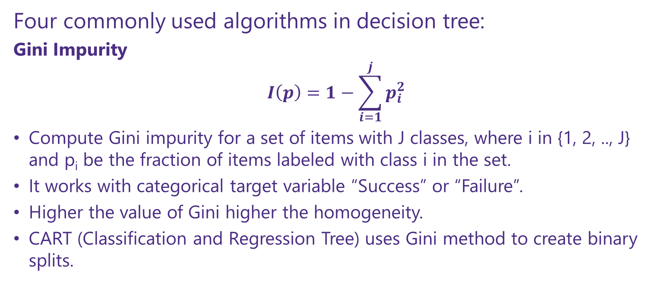
How does a tree decide where to split?
Four commonly used algorithms in decision tree:
Gini Impurity
$$I\left(p\right)=1−\sum_{i=1}^{j}{p_{i}^{2}}$$
Compute Gini impurity for a set of items with J classes, where i in {1, 2, .., J} and p_{i} be the fraction of items labeled with class i in the set.
It works with categorical target variable “Success” or “Failure”.
Higher the value of Gini higher the homogeneity.
CART (Classification and Regression Tree) uses Gini method to create binary splits.

Slide 8
How does a tree decide where to split?
Information Gain:
Less impure node requires less information to describe it and, more impure node requires more information. Information theory is a measure to define this degree of disorganization in a system known as Entropy. If the sample is completely homogeneous, then the entropy is zero and if the sample is an equally divided (50% – 50%), it has entropy of one.

Slide 9
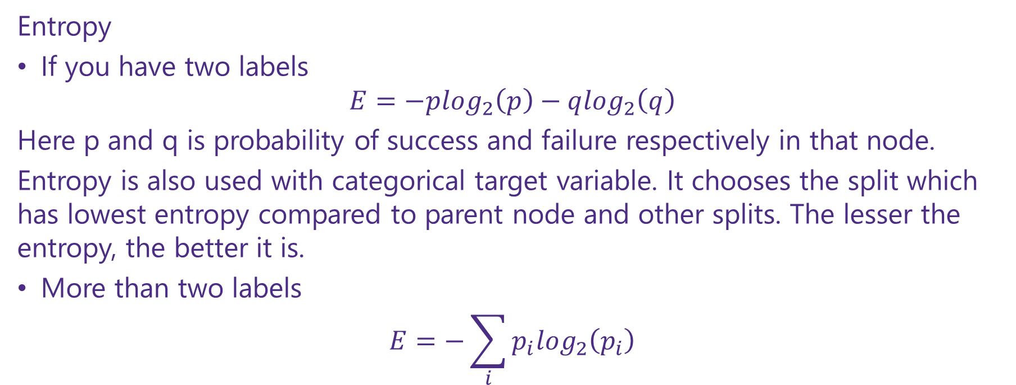
How does a tree decide where to split?
Entropy
If you have two labels
$$E=−p\log_{2}\left(p\right)−q\log_{2}\left(q\right)$$
Here p and q is probability of success and failure respectively in that node.
Entropy is also used with categorical target variable. It chooses the split which has lowest entropy compared to parent node and other splits. The lesser the entropy, the better it is.
More than two labels
$$E=−\sum_{i}{p_{i}\log_{2}\left(p_{i}\right)}$$

Slide 10
Andrew Moore’s Entropy in a nutshell
Low Entropy
High Entropy

Slide 11
Andrew Moore’s Entropy in a nutshell

Slide 12
How does a tree decide where to split?
Chi-Square
It works with categorical target variable “Success” or “Failure”.
It can perform two or more splits.
Higher the value of Chi-Square higher the statistical significance of differences between sub-node and Parent node.
Chi-Square of each node is calculated using formula,
Chi-square = ((Actual – Expected)^2 / Expected)^1/2
It generates tree called CHAID (Chi-square Automatic Interaction Detector)

Slide 13
How does a tree decide where to split?
Reduction in Variance
Used for regression problems
Above X-bar is mean of the values, X is actual, and n is number of values.
Steps to calculate Variance:
Calculate variance for each node.
Calculate variance for each split as weighted average of each node variance.

Slide 14
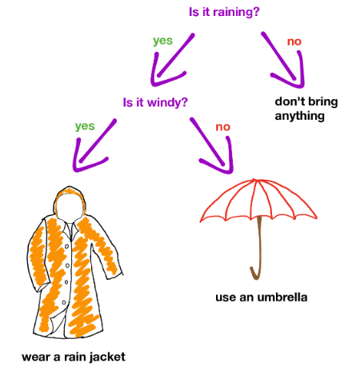
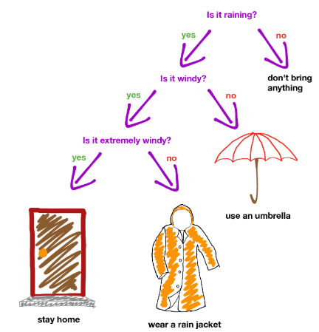
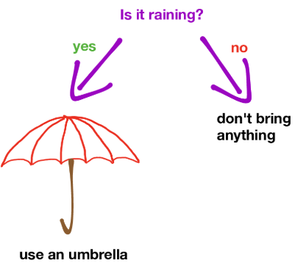
How to construct a Decision Tree?
Choose an attribute (i.e. a feature) for root.
Split data using chosen attribute into disjoint subsets.
Recursive partitioning for each subset.

Slide 15
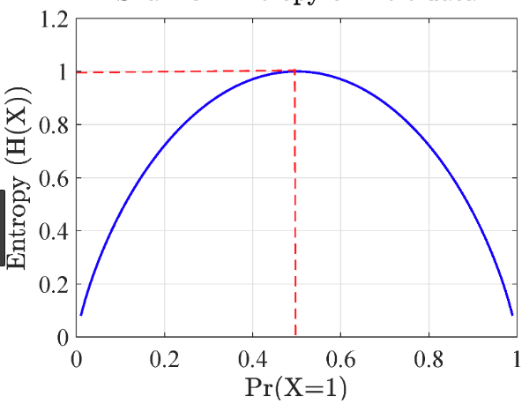
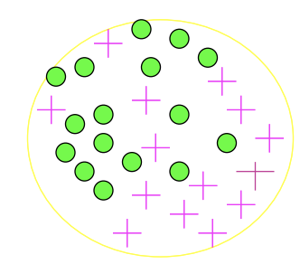
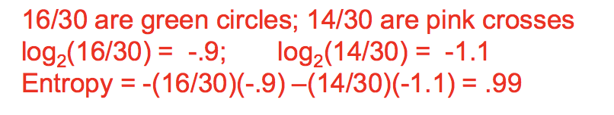
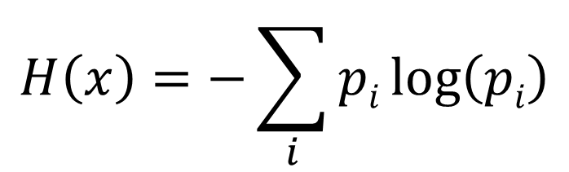
Classification Impurity Measure: Entropy
Entropy measures the level of impurity in a group of examples for classification problems.
$$H\left(x\right)=−\sum_{i}{pi\log\left(pi\right)}$$

Slide 16
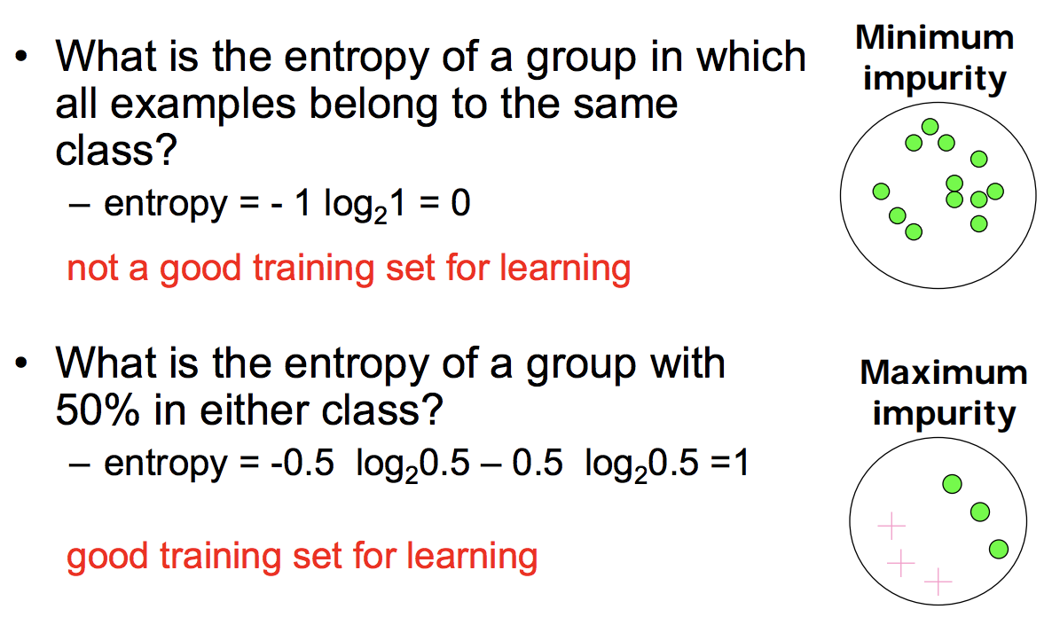
Entropy for 2-class Cases

Slide 17
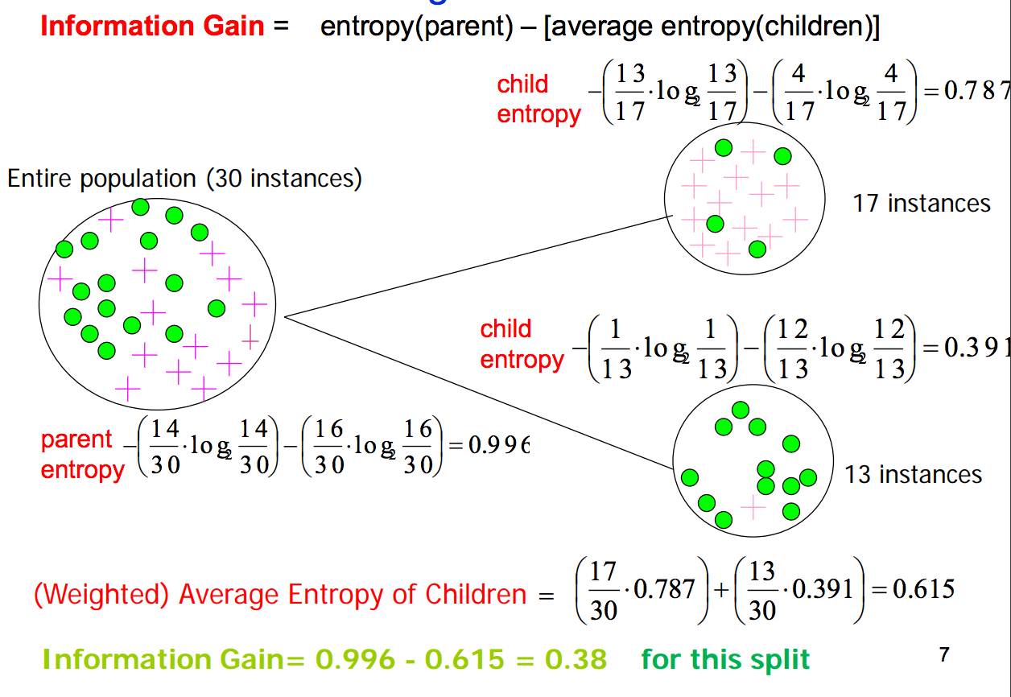
Information Gain Example

Slide 18
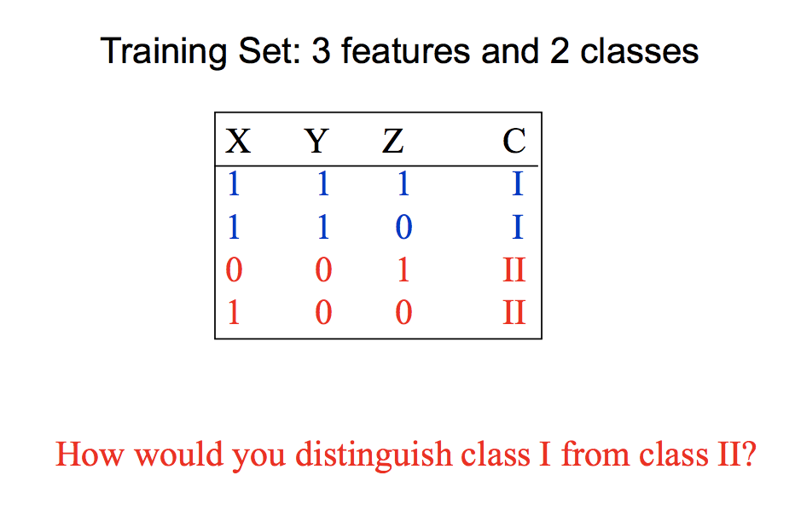
Toy Example

Slide 19
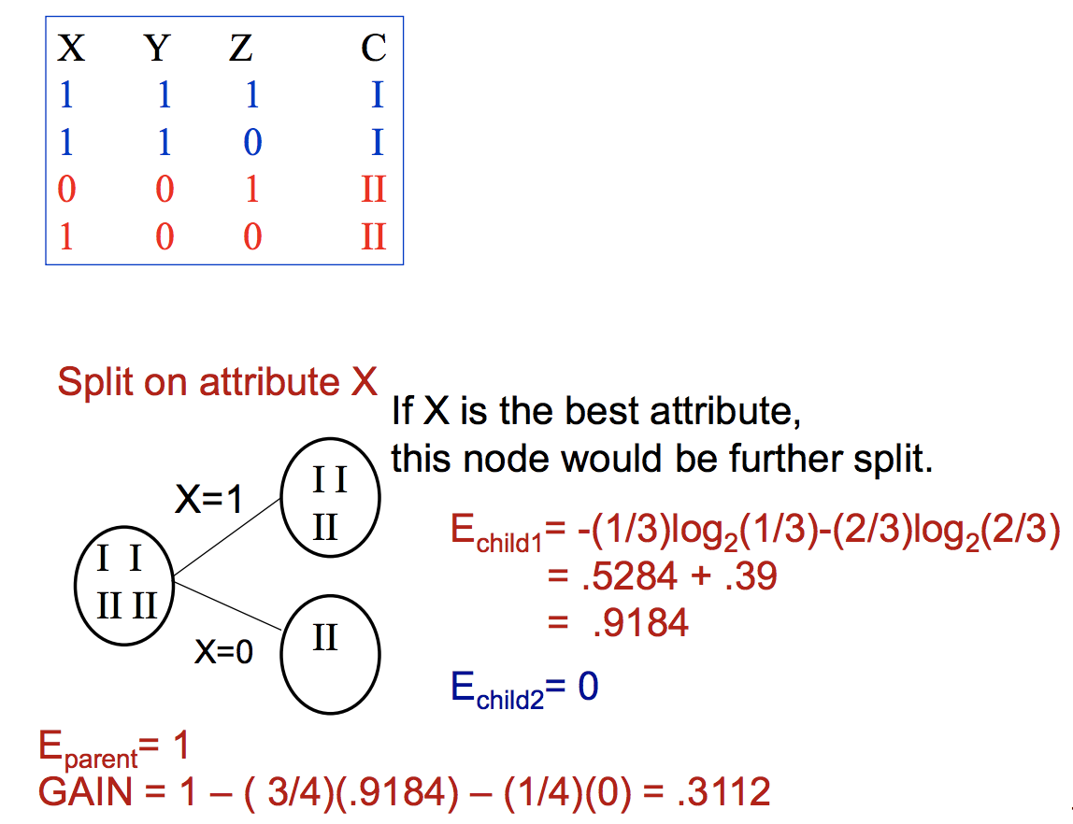
Toy Example

Slide 20
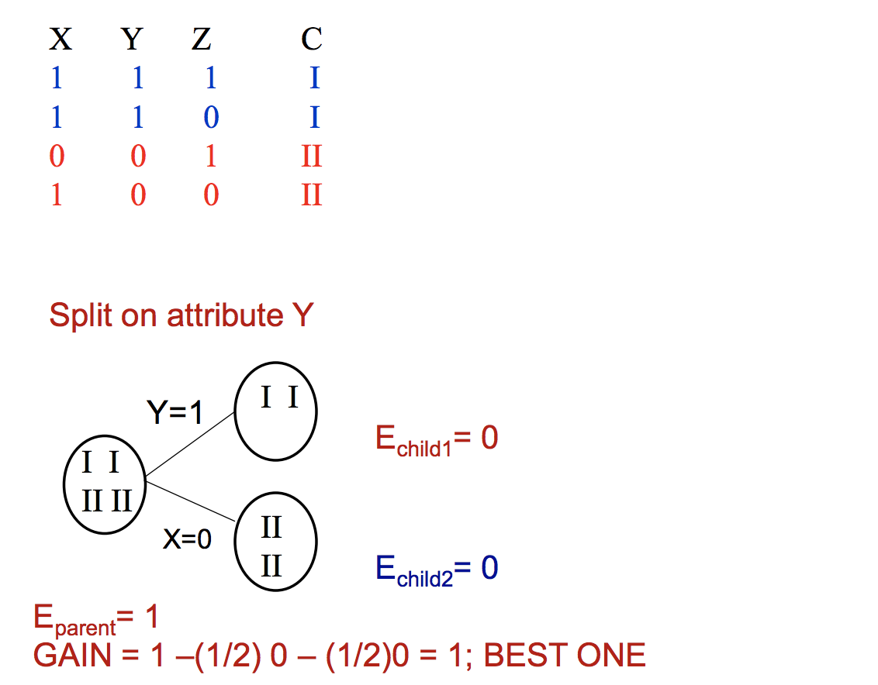
Toy Example

Slide 21
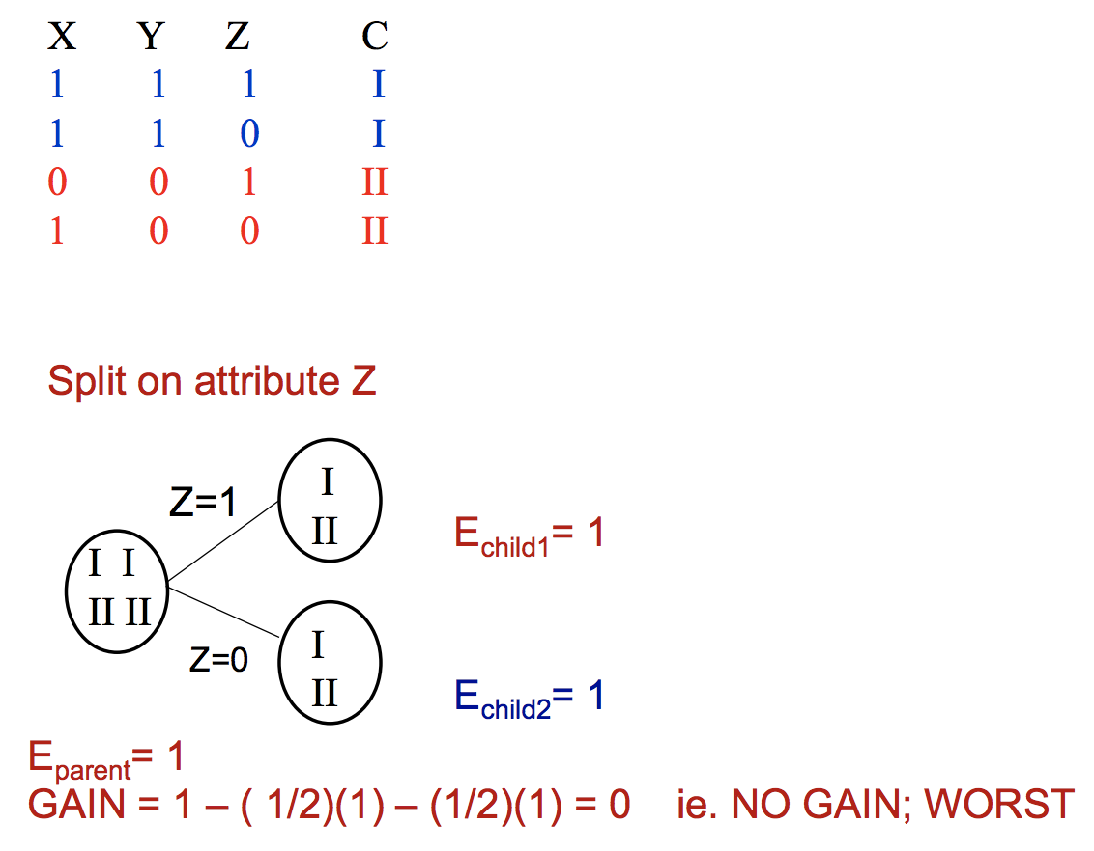
Toy Example

Slide 22
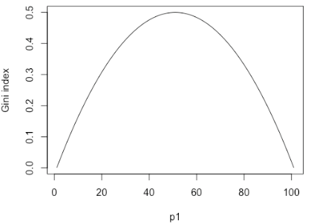
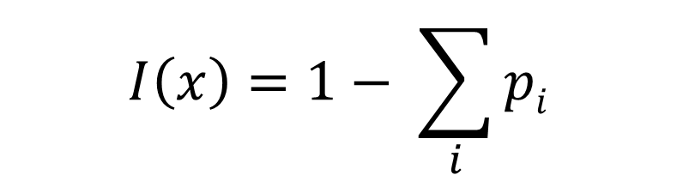
Classification Impurity Measure: Gini Impurity
Gini impurity/index is another measure to quantify the level of impurity in a group of examples.
I(A) = 0 when all cases belong to the same class.
Max value when all classes are equally represented.
$$I\left(x\right)=1− \sum_{i}{pi}$$

Slide 23
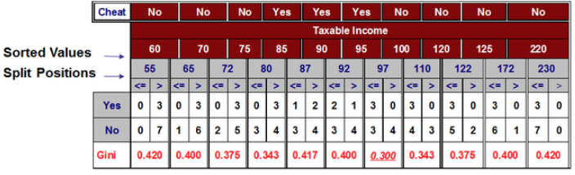
Split of a Numerical Variable
For each numerical attribute:
Sort the attribute from the smallest to the largest.
Linearly scan these values and choose the split position leading to the maximum impurity reduction (i.e. information gain).

Slide 24
Over-fitting in decision trees?
Overfitting is one of the key challenges faced while modeling decision trees.
If there is no limit set of a decision tree, it will give you 100% accuracy on training set because in the worse case it will end up making 1 leaf for each observation.
Thus, preventing overfitting is pivotal while modeling a decision tree and it can be done in 2 ways:
Setting constraints on tree size
Tree pruning

Slide 25
Setting Constraints on Tree Size

Slide 26
Setting Constraints on Tree Size
Minimum samples for a node split
Defines the minimum number of samples (or observations) which are required in a node to be considered for splitting.
Used to control over-fitting. Higher values prevent a model from learning relations which might be highly specific to the particular sample selected for a tree.
Too high values can lead to under-fitting hence, it should be tuned using CV.

Slide 27
Setting Constraints on Tree Size
Minimum samples for a terminal node (leaf)
Defines the minimum samples (or observations) required in a terminal node or leaf.
Used to control over-fitting similar to min_samples_split.
Generally lower values should be chosen for imbalanced class problems because the regions in which the minority class will be in majority will be very small.

Slide 28
Setting Constraints on Tree Size
Maximum depth of tree (vertical depth)
The maximum depth of a tree.
Used to control over-fitting as higher depth will allow model to learn relations very specific to a particular sample.
Should be tuned using CV.

Slide 29
Tree Pruning
The technique of setting constraint is a greedy-approach. In other words, it will check for the best split instantaneously and move forward until one of the specified stopping conditions are reached.
Pruning works differently:
We first make the decision tree to a large depth.
Then we start at the bottom and start removing leaves which are giving us negative returns when compared from the top.
Suppose a split is giving us a gain of say -10 (loss of 10) and then the next split on that gives us a gain of 20. A simple decision tree will stop at step 1 but in pruning, we will see that the overall gain is +10 and keep both leaves.
Pruning Example

